Slide 1
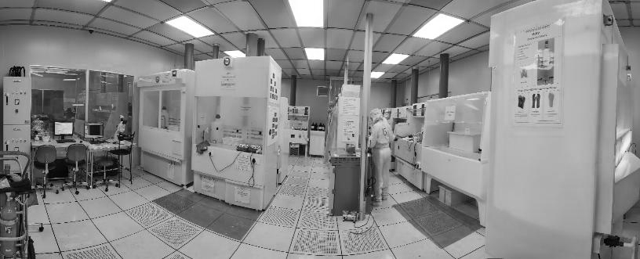
NNFC Safety training
National Nanofabrication Centre(NNFC)
Centre for Nano Science and Engineering (CeNSE)

Slide 2


Emergency: Call 115
General Instruction during an Emergency situation
When facility emergency alarms ring, please evacuate through the nearest exit immediately, DO NOT wait for any announcements
Do not wait to remove the gown and PPE during the evacuation
Do not waste time collecting your belongings like phone, notepad, laptop, etc;
Call BMS: “115” if you need any emergency assistance

Slide 3
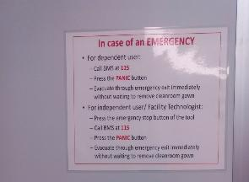
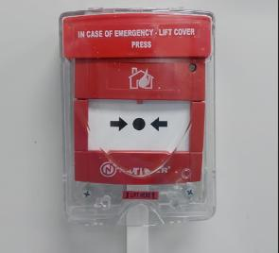
Emergency response in case of an incident
Two facility staff members will always be present in the BMS Control Room.
BMS personnel are trained on the Emergency Shutdown of the tool
Posters are kept in each bay detailing the emergency evacuation procedure, and the panic button is clearly marked
Document detailing emergency shutdown of tools – one copy in BMS, one at the bay
Evacuate from the cleanroom if power does not restore after 2 minutes as circulation also stops
Note: Panic Button are to be pressed only for Facility Emergency and not for personnel emergency.

Slide 4
Alarm Response
If you hear Fire and Smoke alarm
  Emergency Action:
  Evacuate through the nearest exit without wasting time and wait near the Assembly for the headcount
Gas alarms
  Specific to equipment, mainly LPCVD and Diffusion furnace,
  NEED TO INFORM BMS SINCE IT IS ONLY A TOOL ALARM AND NOT CONNECTED WITH BMS
  Emergency Action:
  Evacuate immediately through the emergency exit
  Inform BMS by calling 115 from the cleanroom outside corridor phones
Evacuate cleanroom if power does not restore in 2 min

Slide 5
Emergency response in case of any incident
During Non-office Hours, if you see fire or smoke inside the cleanroom
-Press the Panic button nearby
-Evacuate through the nearest exit and wait near the Assembly for the head count
During Non-office Hours, if you see fire or smoke in the Tool.
-Press the EMO of the Tool.
-Press Panic button nearby
- Evacuate through the nearest exit
- Inform BMS
-Wait near the Safe Assembly point which is right front of the CeNSE building for the head count
-Inform FT/ Technology Manager through email/FOM
-Update Tool down message in user group.

Slide 6
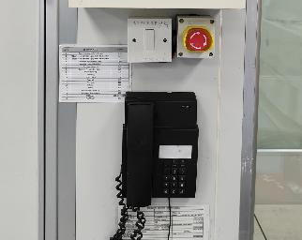
Response for Neutralization Tank Alarm/Beep
When fluids drain down the wet benches, they are directed into a neutralization tank.
The neutralization tank has an active neutralization system that measures the pH and supplies a 50% concentrated Sodium Hydroxide solution to the tank in a programmed cycle to neutralize the acid.
When the fluid level rises to 90% of the tank capacity, one will hear the beep sound in the Wet etch area.
Response: Inform the BMS by calling 115. And follow the instructions from the Facility Engineer.
Button to cease the Neutralization alarm after informing BMS

Slide 7
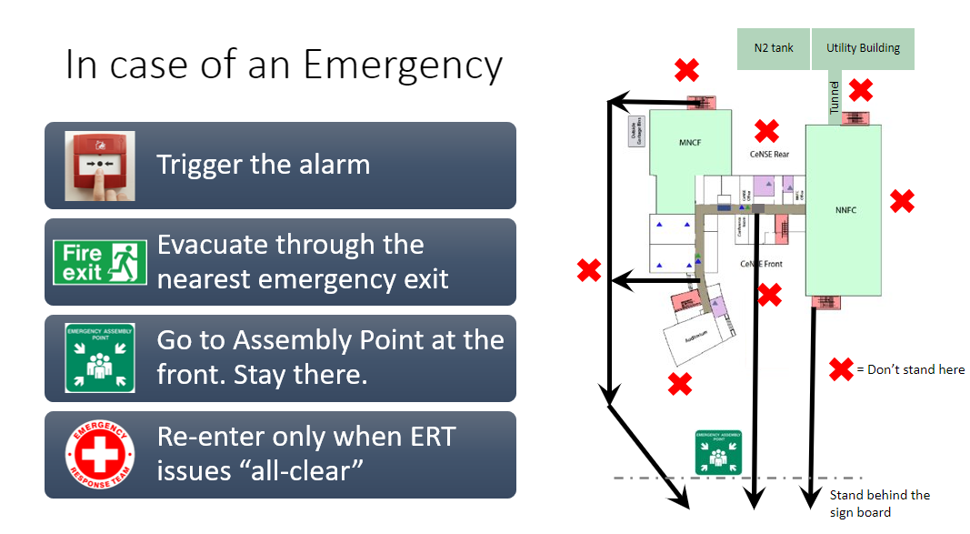
To Summarize…!!

Slide 8

In case of tool break down-Tool issues
Inform BMS immediately if it is a safety concerns
Concerned facility technologist during fab working hours or if it is a safety issue (phone numbers available in Bay emergency contact list/ FOM)
  Call from outside the fab incase of network problem
Send ‘Instrument problem report’ to the instrument managers using FOM
  Log off and press the “something wrong” button
If unable to contact FT’s, please put the tool down notice and send an email to the FT and technology manager, after letting the BMS know
Send an email in the user group so that the next user is aware
DO NOT TRY TO REPAIR BY YOURSELF

Slide 9
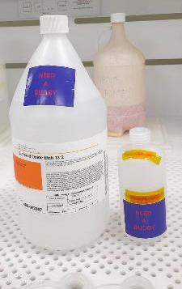


Buddy System: One rule not to be forgotten
Buddy system need to be followed strictly at all times
  Someone needs to know where you are and what your process is
  This is for your safety and this is the law
  In the wet bay, the buddy need to be in the bay itself, if you are handling HF or HF based etchants
Buddy System Saves Life

Slide 10
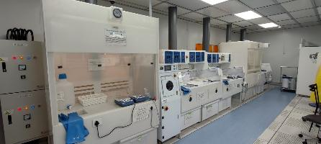
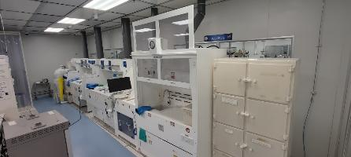
Chemical Safety training
Working in fume hoods and chemical wet benches always requires special attention...!!!–Follow fume hood guidelines of OLSEH, IISc.
Choose the appropriate wet benches based on the contamination policy or levels
Refer to the wet bench user document to identify which types of processes are feasible on a particular wet bench. (Under Wet bench Specifications-User document)
Wet benches are the only safe places for chemicals

Slide 11
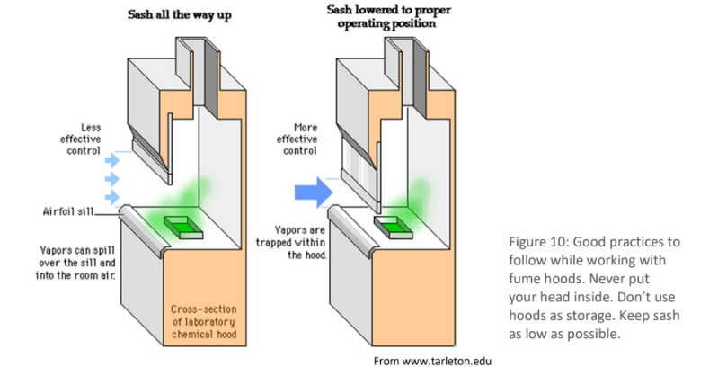
Fume hood guidelines of OLSEH
Keep the sash of hood as low as possible to prevent chemical vapors from back-flowing.
Chemicals must be placed at least 6 inches inside the face of the hood.
The user should always remain outside the hood. Never peer inside.

Slide 12
Chemical Safety training
All chemicals in the fab are hazardous. Ensure that you have read the SDS of the chemical before use. SDS sheets are available with BMS or at the cleanroom corridor or the respective bay.
Always use appropriate amount of chemicals…Do not waste the expensive MOS grade chemicals…!
Never rub in your eyes or face with your hands or gloves.
Never touch the phone or the taps wearing contaminated gloves
AAA principle: Always Add Acid to Water
SOMEBODY WORKING AFTER YOU IN A LAB HAS TO TRUST EVERYTHING IS CLEAN!

Slide 13
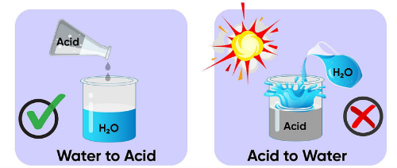
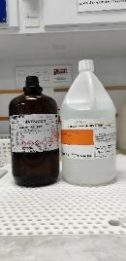


Chemical Safety
Acetone
Peroxide
Never work together with Flammables and Oxidizers..!!
FLAMMABLES
OXIDIZERS

Slide 14
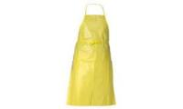




Wet Bench Protocol-PPE’s available in wet Etch
While working on wet bench, it is mandatory to
  Chemical resistant Aprons
  Wear chemical resistant sleeves
  Wear safety glasses & face shield
  Wear appropriate chemical resistant gloves
  Make sure the exhaust is functioning by checking the Magnehelic gauge readings

Slide 15
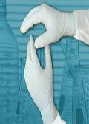
Use of gloves
NITRILLE
  Thin chemical resistant gloves
  Strong material : used for protection against dilute acids
TRIONIC (MAPA)
  Thick chemical resistant gloves : used for cleaning up leaks
  Nevertheless don’t put your hands in liquid chemicals!
F-Telon Gloves
  Thick special nitrile gloves, resistant against HF, Sulphuric acid aqua regia etc.;
Notes:
The choice of gloves is dependent of the kind and the duration of the work that has to be executed with them and the kind of chemicals that have to be manipulated.
Certain tests are done to check the resistance to chemicals and the strength of the material.
Before use the gloves should be checked to see if there are any holes in them.
The reuse of gloves should be avoided. Only the thick Trionic (Mapa) gloves can be reused, but make sure they are not contaminated.
Other gloves should be thrown away inside out immediately after use so that the contamination stays at the inside.

Slide 16
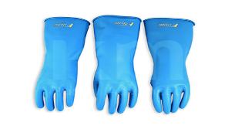
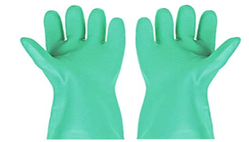
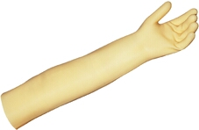
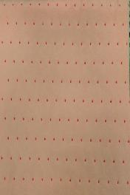
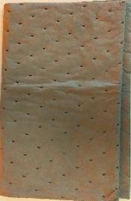
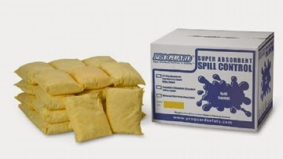
Use of gloves
F-telon gloves (Teflon incorporated)
TRIONIC (MAPA
Chemical spill pads for acids (pink) and organic solvents (grey)
Chemical spill pillows

Slide 17
PPE sequence
Nitrile gloves on top of the gowning gloves
Aprons
Sleeves
Goggles/Face-shield
MAPA/ F-telon Gloves
Please note : F-telon gloves need to be worn while using HF/BHF-any etchants containing Hydrofluoric acid

Slide 18
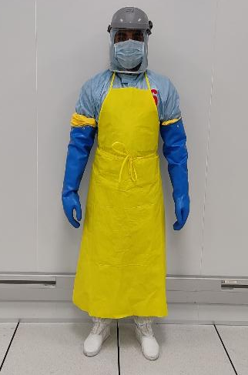
Gowning protocol for Hydrofluoric acid

Slide 19
While wearing PPE
Do not touch with your contaminated gloves,
  Face shield/Apron/sleeves
  Cleanroom Gown
  Mobile
  Taps
  Phone
  Wet etch computer
“No walking around the Fab wearing wet etch PPE”

Slide 20
Removing PPE
Removal in the order
  Contaminated gloves, wash and keep in its place
  Sleeves, fold and keep
  Face shield in place
  Goggles incase
  Apron
ACCESS TO THE WET ETCH WILL BE DENIED IF PPE RULES ARE VIOLATED

Slide 21

What is an SDS?
What is an Safety Data Sheet
  Tells what chemicals are in the product,
  What the hazards of the chemicals are
  How to protect yourself from the hazards.
Where to get S.D.S
  Manufacturer websites, or
  Google search “SDS + name of chemical product” MUST READ !!
  In Every bay with particular chemical details…you can ask cleanroom staff.
The label on the bottle also will contain some relevant information..!!

Slide 22
Hazard Symbols

Slide 23
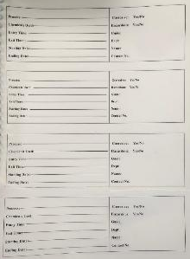
Chemical Transportation
Chemicals should be used only in the fume hoods
Do not carry chemicals by hand Use bottle carriers (Secondary Containers) when transporting bottles.
Do not transport chemicals that are incompatible. Never transport acids with solvents or bases
All chemicals in the bay need to be labeled
Solutions left for cooling/later use need to be indentified using identification chit
Wear nitrile / acid resistant glove depending on your experiment.
NO CHEMICALS INCLUDING WATER SHALL BE USED IN THE FAB WITHOUT PROPER LABELING

Slide 24
Chemical Storage
Chemicals are stored in the properly designated areas with appropriate labels underneath the chemical wet benches
Signs are posted next to the chemical storage
All the chemicals for easy usage have been transferred to small bottles
Use them judiciously as they are of MOS Grade..!!!

Slide 25
NNFC Disposal Protocol
Alkali’s and Acids can be poured down the drain after cooling!
HF and BHF solutions to be disposed in a single plastic bottle
Chrome etch to be disposed into the designated plastic bottle
Organic solvents (Acetone, IPA, Methanol) in a separate bottle, separate bench provided, should not be poured down the drain
Do not leave anything on the wet bench uncleaned/unclaimed after use
Si wafer/glass pieces to be discarded in the designated bin at the wet etch/dry etch

Slide 26
Why is disposal procedure important?
Improper disposal can cause major accidents
Severe accidents can result from mixing of incompatible chemicals, for eg:
  Nitric acid with acetone/ ethanol/ acetic acid
    Results in fire and explosion
  Hydrogen peroxide with organic solvents
    Results in fire and explosion

Slide 27
Use of glassware
Fluoride solutions to be used only in plastic beakers-PP / petridishes / measuring cylinders
  Fluoride etches glass!
Other acids to be used only in glass beakers
Exchange of glassware between benches strictly not allowed
  Glassware is labeled and belongs to particular benches as per contamination policy

Slide 28
Chemical spill On person
Remove contaminated clothing and get under safety shower
Use eye wash for minimum of 15 min if splashed into eyes
Inform BMS and seek medical attention
Please note the location of safety showers and eye showers in the layout slide
Eye Shower
Safety Shower

Slide 29
Chemical spill on the Floor
  Small
    Contain the spill using chemical spill pillows
    Dilute the spill with water and put spill blankets
    Discard spill blankets and pillows in the plastic dustbin
  Big
    Come out and close the door to the wet etch
    Pull the red tape across the door to prevent further entry
    Inform BMS immediately
    Take precautions not to breathe in the fumes

Slide 30
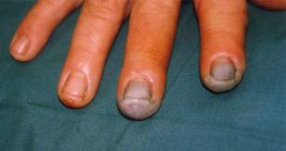
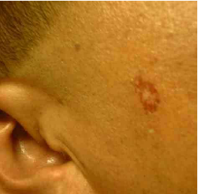
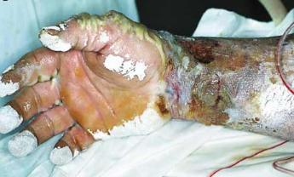
Fluoride Solutions
Hydrofluoric acid and Buffered HF solution
  Equally hazardous
  Highly dangerous due to the internal tissue and bone damage (Decalcification) caused by contact with the colour less liquid!
  Painful treatment in hospital (death possible)
HF/BHF burns

Slide 31
Symptoms HF injury: HF 50%
Almost immediate deep throbbing pain, burning feeling,(especially at hands and finger tips)
Red discoloration with whitish blister, tissue under skin starts dying off, bone de-mineralises
Need only 1% body surface area to be exposed
Systemic fluoride intoxication
Painful treatment in hospital (death possible)

Slide 32
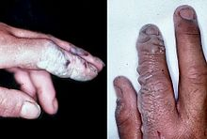
Symptoms of HF injury: Diluted HF solution ≤ 20%
Sometimes it can take upto 24 hours before symptoms appear (pain, rash)
Might result in deeper penetration and more painful burn (especially at hands and finger tips )
The surface symptoms are minimal or may be absent
Can cause white discolored skin, blisters seldom form
HF solution >20%<49%:
Symptoms sometimes just noticeable after a few hours!
Treat all unlabelled, water-like solutions as HF solutions

Slide 33
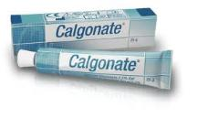
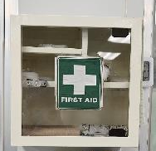
First Aid
  Wash with large amounts of running water (minimum 15min)
  Rub in Calcium gluconate gel (make sure your hand is not contaminated) and cover the burn with plastic foil
  Seek medical attention
  Calcium Gluconate Gel is in the First aid box at the wet etch
  If the spill on the eye, please wash with large amounts of
  water and rush to the hospital
Most of the harm from HF exposure can be minimized if washed within minutes

Slide 34
Other Acids and Bases in Fab..!!
Strong acids used:
  Sulfuric, Nitric, Hydrochloric, Phosphoric
Weak acid used
  Acetic acid
Bases used
  Potassium hydroxide, TMAH
The strong acids & bases are poisonous, corrosive, and will cause severe burns to body tissue.
  Long term exposure will cause lung and tooth damage.
  The weak acids will cause eye, skin and mucous membrane irritation and burns.
  Some are even carcinogenic or teratogenic.
  TMAH and KOH causes severe eye damage and blindness
  Exposure to 25% TMAH might cause respiratory failure
Acetone, Isopropyl Alcohol (IPA) and Methanol:
  All solvents may cause skin and eye irritation. They are colorless & combustible, should NEVER be heated for use. Solvent vapors are toxic, use only in ventilated hoods.

Slide 35
Penalty points for violatons
(nx times for second violation)
Follow all the cleanroom and safety rules of NNFC
Any deviation from this will be considered as violation and will result in appropriate disciplinary action based on the discretion of the NNFC management, it might include the suspension of your access to cleanroom.

Slide 36

Photoresists
Photoresists are organic polymers which change their chemical structure when exposed to ultraviolet light.
  They are generally flammable and should be kept away from any source of heat and ignition.
  Could be carcinogenic / irritant/ harmful / cause depression of central nervous system and damage to liver and kidneys
  Protective gear has to be used at all times when dealing with Photoresists
Photoresist Developers
Mostly use TMAH (Tetra methyl ammonium hydroxide)
  Severe eye damage might effect from exposure to TMAH
  Could cause chemical burns on skin contact
  Dermal exposure might also cause respiratory failure/ cardiac arrest
On skin contact , wash with large amounts of running water (minimum 15 minutes) and contact BMS. PPE’s mandatory at developing stations

Slide 37
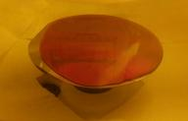
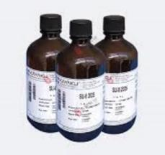
Photoresist /Developer Handling Protocols
Its mandatory to wear two set of gloves inside the Litho Bay along with chemical resistant sleeves.
Ensure photoresist/developer contaminated gloves and wipes are disposed in the dedicated bin, which is located inside the spin coater work station under exhaust.
Do not touch the tools, computer, face shield or any other object or document with photo resist contaminated glove, failing which lead to penalty.
Never keep the PR containers near the HOT Plate!!!
Never displace the resist from its designated place.
Do not leave developer/Resist bottle open….!!!!

Slide 38

Responsibilities: Independent user
Independent user is responsible for the tool during non-office hours
Undergo Re-orientation every year.
We are responsible for the Tool during non-office hours

Slide 39
Chemical spill
On person
Remove clothing and get under safety shower
On bench/ floor
Dilute with water and absorb the spill using chemical spill blankets/ pillows
Inform BMS immediately at 115
Try not to breathe the fumes
Dispose the spill blankets in the plastic dustbin
Evacuate and put red tape across the door preventing user entry
Call BMS immediately at 115
Minor Spill Criteria
Not in immediate danger of an explosion, fire or a health issue
Not spreading further (is only on small area (<2x2 ft) and is not HF
Dangerous only by direct contact
Can be managed by existing PPE
Minor spill
Major spill

Slide 40
HF spill on Body
HF exposure
Wash with
running water (min15 min)
Apply calcium gluconate gel using uncontaminated gloves
Call BMS immediately at 115
Remove Contaminated Gloves/ clothing's
Continue to apply until you reach health centre

Slide 41
List of emergency personnel and Local officials
​ | Contact​ | Number​
IISc​ | ERT Team​ | EPABX: 115 P: 080-23229333-24​
 | Engineering​ | EPABX: 128/114/113 P: 8971118917, 9535550474, 9901011042, 7795385941​
 | IISc safety control room​ | 5555, (080-22935555)​
 | IISc Security​ | 080-22932400/080-22932225 CSO: 9845450888​
 | ICU on Wheels (IISc)​ | 8147665421​
 | OLSEH Office​ | 080-22933199​
 | IISc Health center/Ambulance​ | 080-22932390/080-22932227 CMO: 9845109752 MO-9448430922 ​
 | CCMD​ | 2345, 2206 ​
 | Electrical Engineer​ | 9448697395, 9663071172​
 | Estate officer​ | 9845376377​
Outside​ | Yeshwanthpur fire station​ | 080-101, 080-22971544​
 | Sadashivanagara police station​ | 080-100, 080-22942589​
 | Ambulance​ | 080-102 080-108​
 | Mallya Hospital​ | 080-22242325​
 | M. S. Ramaiah Hospital​ | 080-23608888​
 | Manipal Hospital​ | 080-25211200 ​
 | Columbia Asia​ | 080-39898969​
 | Narayana Hrudayalaya​ | 080-27835000-18​

Slide 42



