Slide 1
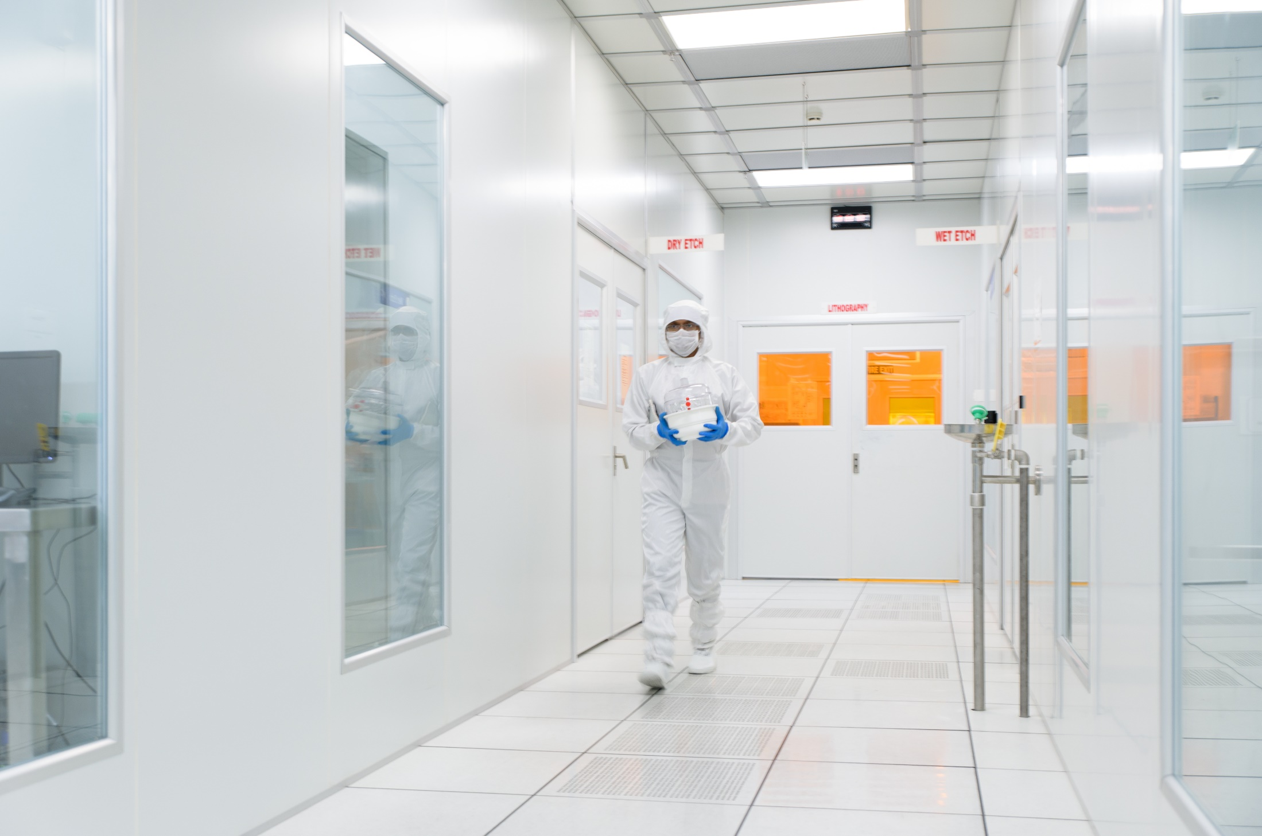
NNFC Cleanroom protocols
National Nano Fabrication Centre(NNFC)
Centre for Nanoscience and Engineering(CeNSE)
Indian Institute if science(IISc)
Bangalore-12

Slide 2
Contents
Introduction – Cleanroom (CR), CR training
Clean room Protocols
Equipment Use-FOM and Training
Contamination in CR
Gowning and Personal Protective Equipment (PPE)
Procedure for withdrawal of Materials
Equipment Training
Contamination Policy
Policy for bringing gadgets or accessories

Slide 3
Introduction
What is a clean room?
As per ISO standard-14644-1:2015
“Room in which the number of airborne particles is controlled and classified, and which is designed, constructed and operated in a manner to control the introduction, generation and retention of particles inside the room and in which other relevant parameters such as temperature ,humidity, pressure are controlled as necessary”
Why cleanroom training?
The Clean room environment is carefully maintained at particular standards and has equipment's which are delicate and precisely calibrated
The chemicals and gases used in the facility may be extremely hazardous
Mis-use may lead, not only to destruction/malfunctioning of the device, but could also pose danger to personnel/instrument

Slide 4
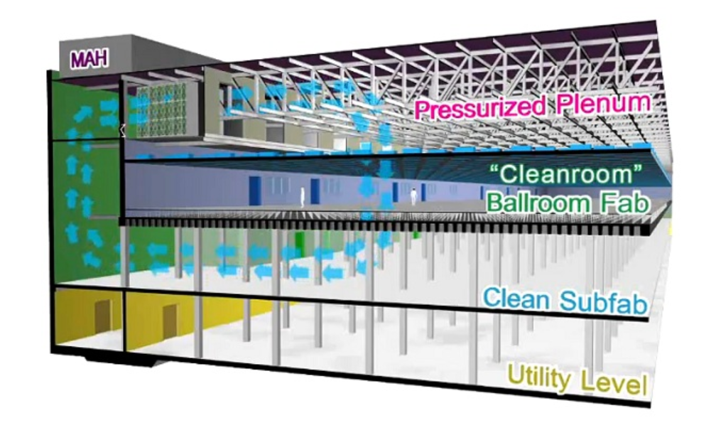
Cleanroom structure
INTEL AND MICRON 25NM FLASH MEMORY PRODUCTION

Slide 5
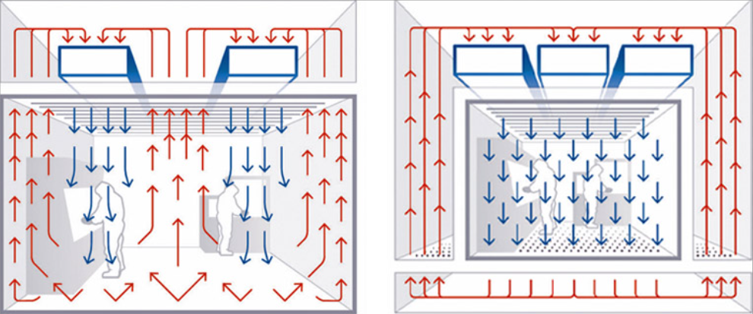
Principles of the Clean Environment
HEPA- Filter
“Dilution effect“- non-parallel /non-uniform flow streams and velocities. clean air entering the room and diluting the contaminated air.
“Piston effect“- where incoming clean air "pushes" contaminated air from the room
NNFC-8000 sq.ft area
NNFC-2000 sq ft area Lithography Area

Slide 6
Cleanroom Classification
Level of cleanliness is defined by ISO or FED standards

Slide 7
Cleanroom Conduct-Responsibility of the User
Proper and professional conduct
Do not cause disturbance or disrupt the procedures of other users
Report any violation noticed immediately to the cleanroom staff
It is the responsibility and need of each user that the fab is maintained at the optimum levels

Slide 8
Cleanroom Protocols
Hours of Operation
-Cleanroom is operational 24x7 on all tools except Wet benches.
- They are unavailable everyday from 2 A.M. to 6 A.M
Access- follow the below steps..!!
Download the authorization form NNFC website
Fill, sign and submit the same to NNFC office
Read clean room protocols and safety documents.
Take the clean room test.-You have only 3 attempts ….!!!/ If not you have to wait for six months for retest.
PASS IT, attend orientation, you will be given access by CeNSE office staffs!
Note: Authority to enter does not mean authority to operate equipment's..!!!
New User Orientation
-online and available in NNFC website.

Slide 9
Cleanroom Entry Protocols-after Access..!!
All authorized users MUST use the biometric access prior to entering.
NO TAILGATING.
Do not allow another users to enter the cleanroom along with you.
After the door closes, he or she will have to log in separately through his or her biometric access.
Do NOT take guests/friends along with you.
Permission is required from NNfC office, even if you need to take a visitor around the corridor.
All visitor details should be logged in the register placed @NNfC Office.
Violation of the above protocols WILL result in permanent suspension of access to the facility.

Slide 10
Before every entry to cleanroom..
Please wash your hands and face with lots of water and dry before coming into the clean room
If you ate something just before coming into the cleanroom, drink water and rinse your mouth thoroughly
If you smoke, drink water before coming into the cleanroom
Do not come in with torn and/or dirty socks/ stinky foot wares.

Slide 11
Before every entry to cleanroom..
Wear Clean and dry clothes .
Churidhars ,Salwars T-Shirts are allowed.
Clean socks or stockings are mandatory.-wear the foot covers ..!!
Please make sure that long or medium length hair is tied back.-open hair entry is restricted
“Contact lenses are strictly prohibited”
People with pacemakers or any metal implants and pregnant women should consult NNFC office before you proceed.

Slide 12
Before every entry to cleanroom: Not allowed
Clothes which are dusty, dirty or wet ,avoid entry with sweet stinky body
Sleeveless clothes, shorts or short-pants
Tank tops, halter tops and sphagetti strap tops, sarees, shorts, skirts and gowns
Clothes which shred fiber like fur, mohair etc
Deodorants, perfumes , kajals and cosmetics including hand cream
Heavy jewellery and decorative accessories including flowers
People suffering from cough, cold or respiratory diseases
X

Slide 13
Cleanroom Don’ts
Cell Phone usage Policy inside cleanroom.
- Cell phone use is strictly prohibited inside NNfC
- Only staffs can use during equipment maintenance/ for any documentation purpose
Do not open the door emergency exits unnecessarily
Do not open the door to the cleanroom for communication or passing of products back and forth – use the pass-through instead.
Do not congregate.
No running and try to maintain silence

Slide 14
EQUIPMENT USE- General Instructions
Two type of users: Dependent/ Independent
Dependent authorized users: Only day time access / process done by facility technologist, please book the slot well in advance
Independent users: Anytime access, after proper training
Talk to your supervisor and the concerned technologist if you need to be an independent user.
Internet usage (including FOM) on equipment computers strictly prohibited. Use of pen-drives is also not allowed, use winSCP to transfer data

Slide 15
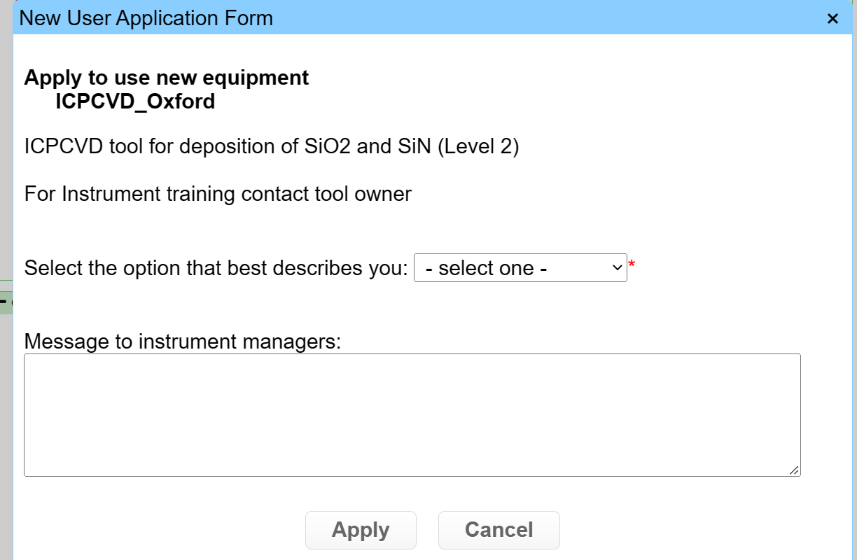
EQUIPMENT USE- Register in FOM
Register in FOM as new user
Use only IISc email ID
Provide Valid financial account number
To Book slot in particular Tool
Request for the access for the same
Wait for the access from the Equipment owner
Contact Equipment owner for any issues related to access. For other issues contact NNfC Office (GF-20)
Agree the Same
Click Apply

Slide 16
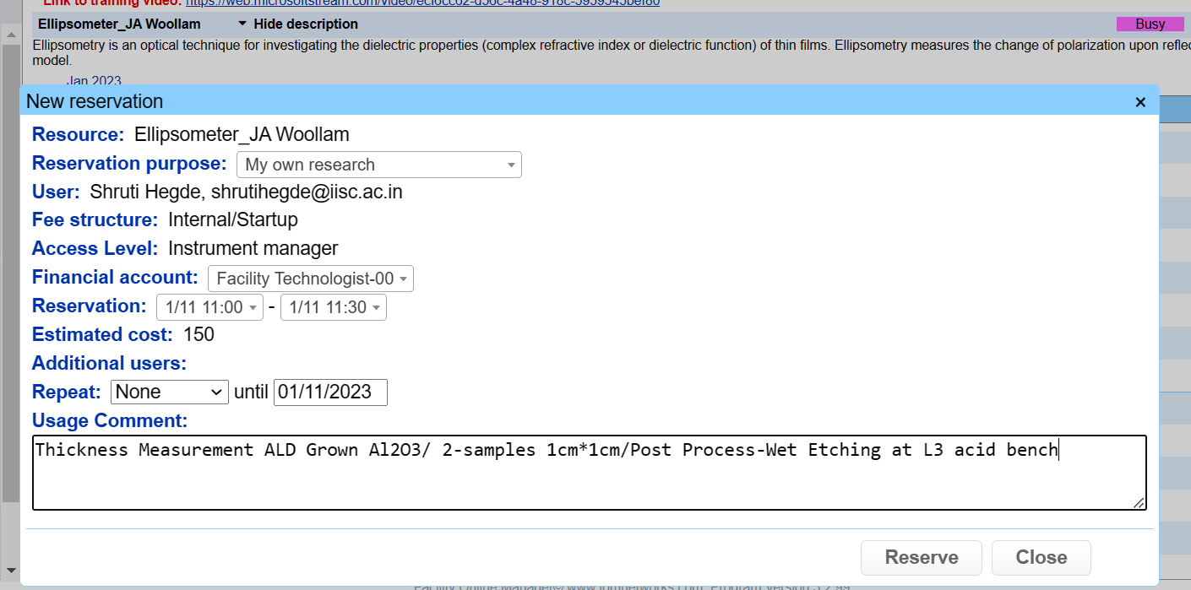
EQUIPMENT USE- FOM Slot Bookings
Slots need to booked using FOM software before tool usage.
Be there with your sample 15 min before your booking starts, 30 minutes before a litho slot
Samples submitted 10 min after the beginning of the slot will not be accepted
If you book, but do not turn up, penalty points as per norms
Also, the slot will be charged

Slide 17
EQUIPMENT USE- Slot cancellation on FOM
Slots booked by dependent users using express logon on FOM will not be honored
Slots booked by dependent users after office hours (10 AM-1 PM, 2PM-5PM)
Slots booked without relevant information, Process conditions, Materials, Number of samples, sample size etc; information (different layers, pre and post process).
Slots booked by users who are under suspension from the cleanroom
More than 40% cancellation of user slots on any Tool will leads to Penalty- Will be Calculated every month and submitted to Admin committee.
3-no show will be penalized.
Two different slots can not be booked in the same time

Slide 18
EQUIPMENT USE- How to Become An Authorized User
Read the protocol and safety document
Safety test can be Repeated 3 times only
Take Cleanroom Test
Pass
User is not authorized to enter cleanroom
Users not passing the test even after 3 attempts should send an email to COO and the decision will be taken by the clean room committee
Dependent users are temporary users (those who will not use the tool more than 3 times)
User is authorized to enter cleanroom
Apply for approval for specific Equipment use using FOM software
Reserve slots and use equipment as dependent user

Slide 19
EQUIPMENT USE- How to Become An Independent User
Apply for Training through FOM
Get trained by equipment owners/Practice
Certification by equipment owners
No
User clears the Drive Test and uses the tool specified no. of times without deviating the SOP
Yes
Becomes an independent user
Tool not used for 40 days
Retraining and certification by equipment owners

Slide 20
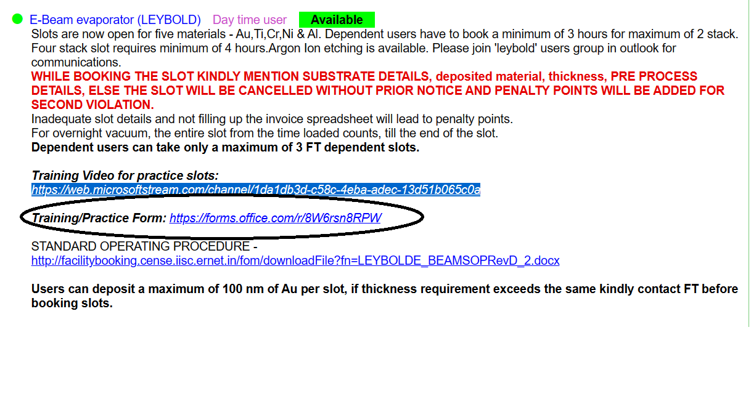
EQUIPMENT USE- How apply for particular tool training.
Except WET Etch, all other tools apply through office training request form,
Click and fill up the form, you will get response from respective Tool Owners.

Slide 21
EQUIPMENT USE- How apply for particular tool training.
For Wet Etch training,
You can apply through FOM, so that your training slots will be reserved.
Hands-on Training slot schedule is as below with required information will be provided on
Every Week | Day | Time
 | Tuesday | 2.30 p.m to 4.30 p.m
 | Thursday | 2.30 p.m to 4.30 p.m

Slide 22
Equipment Use-Equipment break down
Inform the concerned facility technologist (phone numbers available near the phones in the bay)
Inform the equipment owner by email if it is non office hour.
If it is a safety issue immediately inform BMS.-Switch off the Tool by pressing EMO
Send ‘Instrument problem report’ to the instrument managers using FOM
Log off and press the “something wrong” button
If unable to contact FT’s, please put the tool down notice and send an email to the FT and technology manager and in the User group. So that next users will be updated.
DO NOT TRY TO REPAIR BY YOURSELF

Slide 23
EQUIPMENT USE- Need a new process? (Process Request/development)
-In order to raise new process requirement, access the Online Process Request System, all potential users are requested to register at http://nnfc.cense.iisc.ac.in/nnfc/n2fc
Click on “Member Login”, to register yourself. Once registered, please follow the instructions on the Member Dashboard to submit a process request.
All details pertaining to Process Request Submission and Process Request Execution are available in the “Process Request Procedure” Document on the Member /Faculty Dashboard.
Please send the form 2 week in advance of your reservation
Fill the process request at
http://nnfc.cense.iisc.ac.in/nnfc/n2fc/t form
Work with the FT to develop the recipe
Decide feasible/not-feasible and close the request

Slide 24
How to bring new materials or gadgets accessory tools inside?
For new chemicals:
Email to contamination committee (i.e., Dr. Savitha p, savithap@iisc.ac.in) with attached MSDS and purpose of the use with pre and post process details.
-Show the clearance note to required cleanroom staff
For gadgets accessory tools :
- Email to COO of NNFC i.e., Dr. Savitha p, savithap@iisc.ac.in)
- Describe purpose and size of the device.
-Also inform clean room staff the same
-Provide the documentation for use and storage place.

Slide 25
Contamination in cleanroom- 3 categories
• Molecular contaminants
• Surface contaminants
• Particulate contaminants
Notes:
Contamination during process

Slide 26
Airborne molecular contamination (AMC) sources
Out gassing
Oil vapours
Alcohols
Paints, glues, & epoxies
Aromatics; If you can smell it, suspect it as a contaminant
AMC contamination can ruin,
-Devices and circuits
-Production yield.
-Process reliability

Slide 27
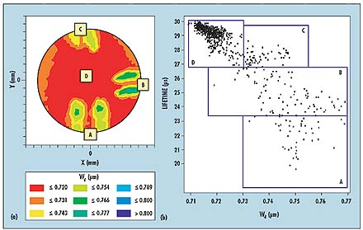
Sources of surface contamination
Finger prints - Oil & grease
Skin oil
Hand cream
Face cream, Wax
Polish
Particulate contamination can ruin,
-Devices and circuits
-Device and equipment controllability.
-Process reliability
http://micromagazine.fabtech.org/archive/06/03/sokolov.html

Slide 28
Sources of particulates
People (skin, scales, hair, clothing lint, etc.)
Particle shedding materials (cardboard boxes, paper)
Abrading actions (drilling, sawing, sanding, etc.)
Bare wood products
Particulate contamination can ruin,
-Device failure-short circuits, pin wholes, open circuits etc;
-Reduce the yield-failed device, many tool hours, fab money
-Mask
X

Slide 29
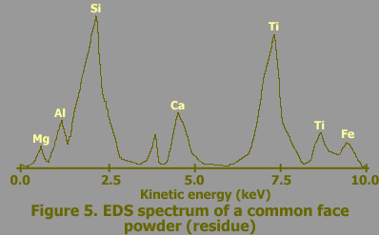
Effect of different cosmetics (http://www.lricks.com/crpage1.htm)
Table I. Chemical Analysis of Skin Flakes Vs Cosmetic Flakes
Electrolytes in Skin Tissue |  | Dominant Elements in Cosmetics
Cations (Concentration in the body) | First Ionization Potential | Element | First Ionization Potential
Na+ (3179 ppm) | -2.710 eV | Ti | 6.82 eV
K+ (152 ppm) | -2.931 eV | Tc | 7.28 eV
Ca++ (14 ppm) | -2.868 eV | P | 10.49 eV
 |  | Si | 8.15 eV
 |  | Al | 5.99 eV
Anions |  | Fe | 7.87 eV
C1- (2556 ppm) | +1.358 eV | Mg | 7.65 eV
HC03- (1664 ppm) | +1.080 eV | Cr | 6.77 eV
-channel threshold voltage | Δ +0.10 VDC
p-channel breakdown voltage | Δ -4.72 VDC
source-drain resistance(N+) | Δ+8.59 Ω/sq.
p-channel threshold voltage | no change
metal 1 to poly+ resistance | > 800 Ω
Change in Electrical parameters of a wafer was contaminated with a common talc

Slide 31
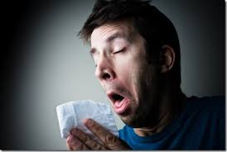
Contamination Sources
People ~75%
Ventilation ~15%
Room Structure ~5%
Equipment ~5%

Slide 32
You are the Primary Contaminant!

Slide 34
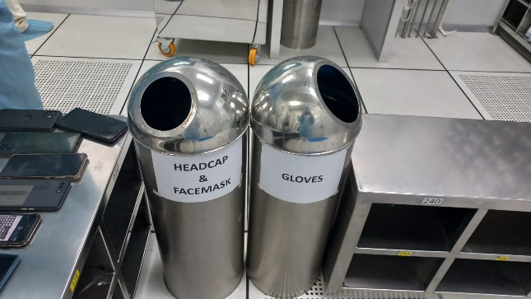
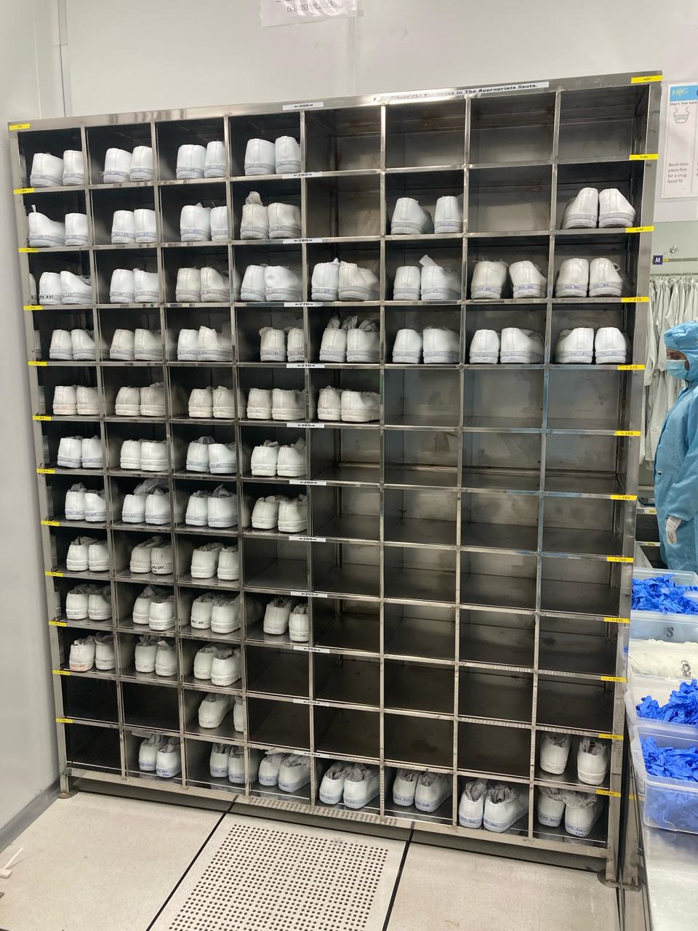
Gowning Procedure
Order of Gowning
Put on the Facemask available in the Gowning area
Followed by Hairnet
Gown/Bunny suit
Booties
Gloves
De-Gowning Procedure
De-gowning is done in reverse to the gowning procedure
– from the feet up.
Note: Properly in place your booties and dispose the
Facemask and hairnet to bin

Slide 35
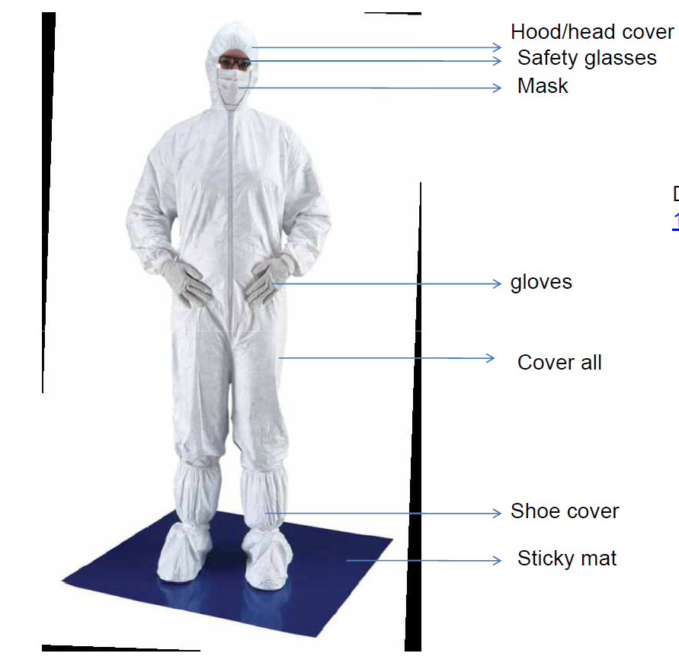
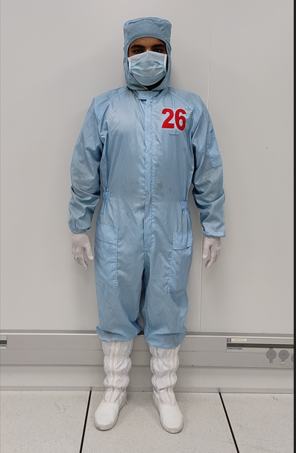
Gowning Procedure
Detailed Gowning /un-gowning Procedure video at NNFC website

Slide 36
Just after you enter
A class 100 area at the entry point
Make sure the door is open from one side
Make sure you spend a few seconds (10-12 sec) there

Slide 37
Q: Why is the procedure important?
Want the dust you generates to fall INSIDE your suit, NOT OUTSIDE.
-So, the boot covers go OVER the suit, NOT UNDER
If you put on your gloves and then use your hands to gather your hair and put it under a cap, the gloves will have oil and skin flecks on the outsides from your hair.

Slide 38
Procedure for withdrawal of Materials (from the NNFC stores)
Consumables to be obtained from plenum storage area between 2.30-3.00pm.
Fill the online withdrawal form available at NNfC website→ Quick links→ Consumable withdrawal/Wafer withdrawal form
Wafers can be obtained from inside the cleanroom between 4.30 and 5.00pm
Needs approval from Supervisor and NNFC office (COO)
Only those registered on FOM can purchase materials
For withdrawals of item like Silicon wafers, consumables like tweezers etc.

Slide 39
Loss of access
Six months of no activity in the cleanroom automatically removes biometric access
Take cleanroom safety test and ask for biometric access again
40 days of no tool use will remove independent access
Ask for retraining
Retraining might consist of just practice slots or full
training depending on the tool
Talk to the concerned FT
Plan in advance: FOM alert will be sent

Slide 40
In case of tool break down
Inform the concerned facility technologist (phone numbers available near the phones in the bay)
Call from outside the fab incase of network problem
Send ‘Instrument problem report’ to the instrument managers using FOM
Log off and press the “something wrong” button
If unable to contact FT’s, please put the tool down notice and send an email to the FT and technology manager
DO NOT TRY TO REPAIR BY YOURSELF

Slide 41
Communications from the Cleanroom
FOM sends a notice to all users
Make sure your registration email is your official IISc email id
Notices cannot be send to other gmail, yahoomail etc
General email to all CENSE users
Regular updates in the respective user groups in Office 365
Broadcast emails send to IISc
Notice on NNFC webpage, FOM “users note”

Slide 42
Contamination policy and General rules
Problem of Cross Contamination
Definition:
Transfer of undesirable materials from one equipment to another.
Occurs because of:
Incompatible process flows : Move from cleanest step to dirty step (downstream). Never upstream.
Irresponsible user behaviour : As long as my work gets done, it is not my problem.
Causes:
Poor device performance and reliability
Poor repeatability of processes
Expensive repair/downtime of equipment

Slide 43
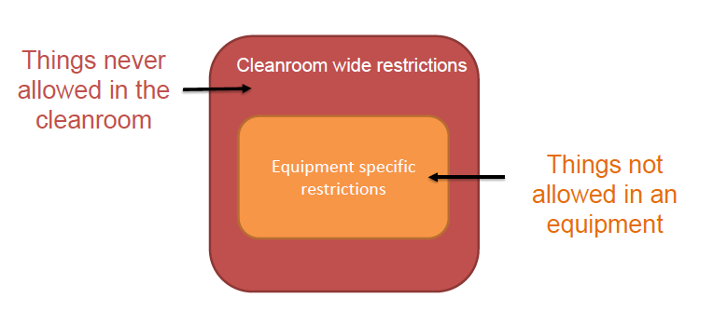
What is the Contamination Policy?
Outlines NNFC’s policy on allowed/disallowed materials in the cleanroom & each of the equipment

Slide 44
Cleanroom-wide Restrictions
Sulfur
- Clogs the pumps and valves.
PDMS
–Please use PV-lab and polymer lab for processing these.
Fast diffusing (Cu, Zn, Fe, Mn, etc.), toxic metals (Cd, Sb, Se, As, Hg, etc.), their alloys
–Entry allowed only on a case-by-case basis
Only approved photoresists allowed in Lithographybay
–Standard list available at FOM (purchase supplies)
Only approved chemicals allowed at the wet bench
–List available at FOM(purchase supplies)

Slide 45
Equipment-Specific Restrictions
Each equipment has a contamination level
Based on the contamination level, entry of materials and samples are restricted.
Basic idea
Sample move from low-contamination to high-contamination

Slide 46
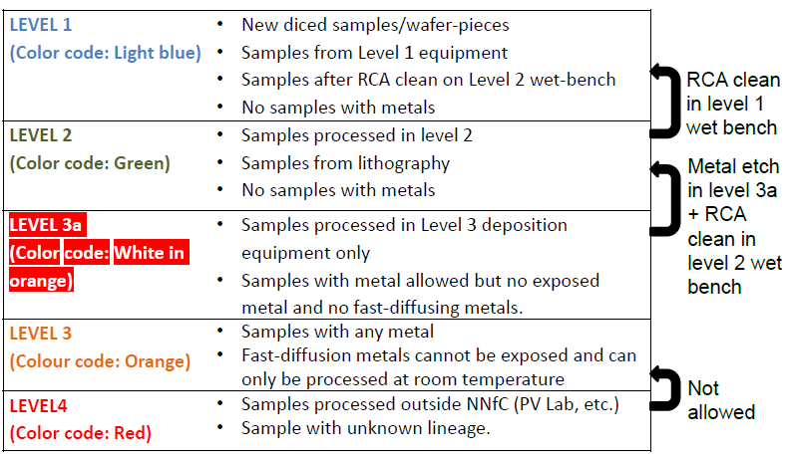
Classification of Equipment (Levels)
Please note that samples processed in Level 3 will not be accepted in level 2 or 1

Slide 47
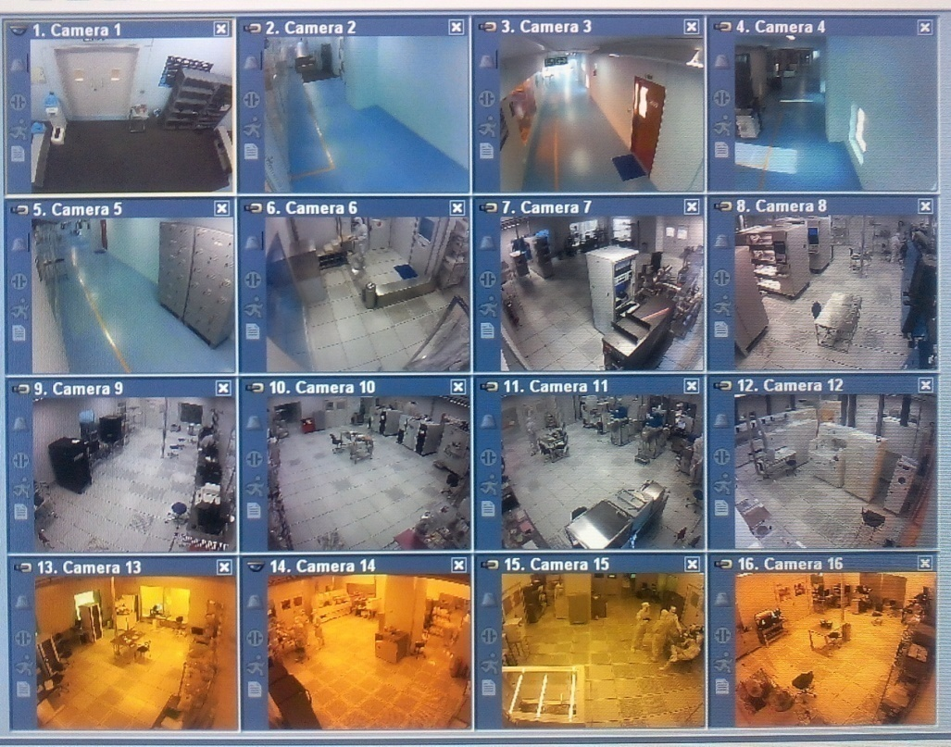
Violation of Rules
Depending on the gravity of violation
You may get just a warning
You may get your booking cancelled
You may loose your registration for a short while
Or
You may loose your clean room registration all together!
REMEMBER, monitoring cameras are everywhere in the clean room!
Rules apply 24X7

Slide 48
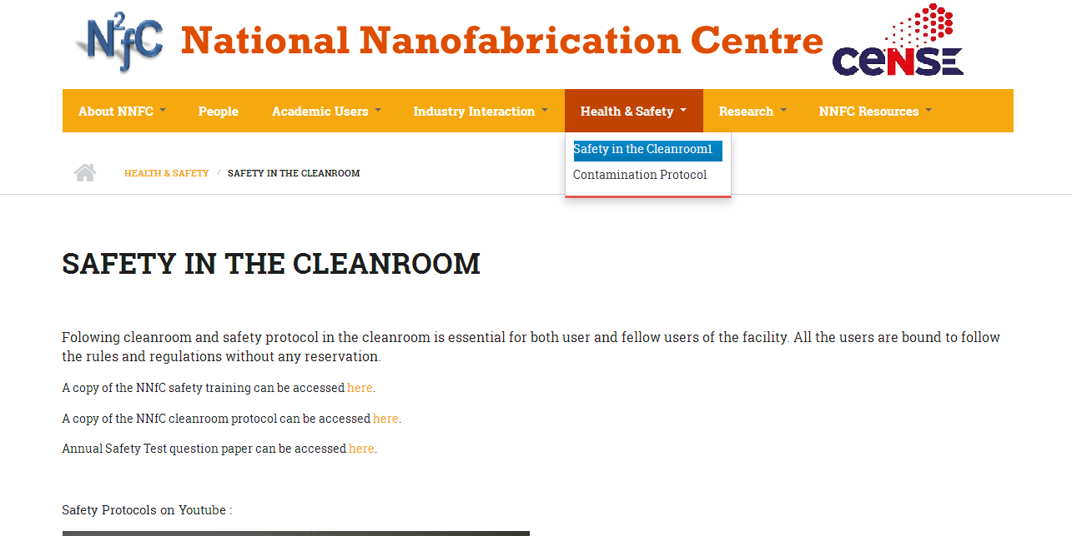
http://nnfc.cense.iisc.ac.in/
Google – nnfc iisc

Slide 49
Thank You

